Slide 1

ME1103 – Principles of Mechanics and Materials
Briefing on Statics and Friction

Slide 2
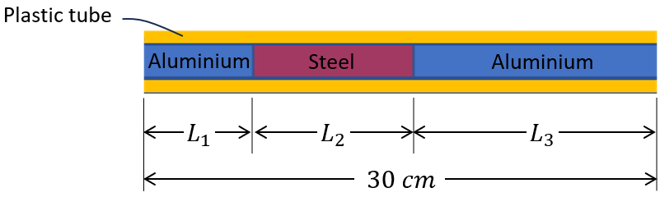
Statics of Mystery Bar
Objective: Applying static analysis to determine the composition of a heterogeneous bar that is made up of aluminum and steel parts.
Determine mass per unit length for the different materials from the samples, i.e. m_{a}, m_{s}, and m_{p}.
Measure the supporting forces R₁, & R₂ when it is placed onto the digital scale.
Given that L₁ + L₂ + L₃ = 300 mm, find their actual lengths?

Slide 3
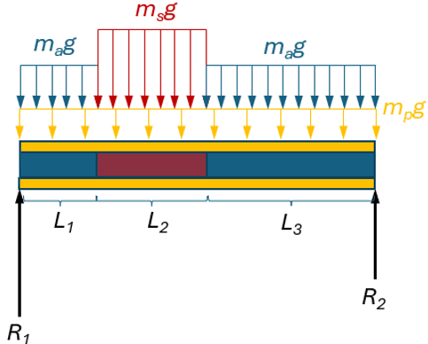
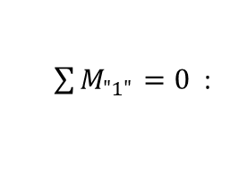
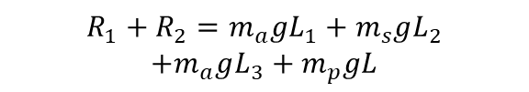
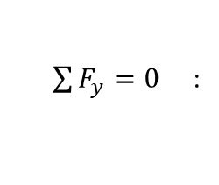
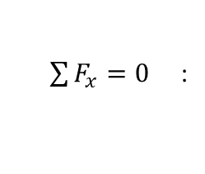

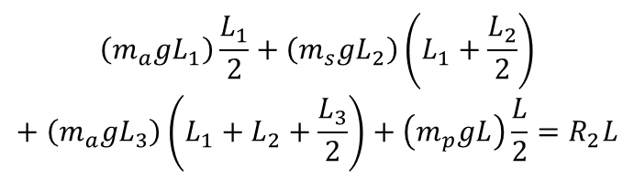
Statics of Mystery Bar…
Static Equilibrium & Free Body Diagram
$\sum{F_{x}}=0$ :
No x-components
$\sum{F_{y}}=0$ :
$$R_{1}+R_{2}=m_{a}gL_{1}+m_{s}gL_{2}$$
$$+m_{a}gL_{3}+m_{p}gL$$
$$\left(m_{a}gL_{1}\right)\frac{L_{1}}{2}+\left(m_{s}gL_{2}\right)\left(L_{1}+\frac{L_{2}}{2}\right)+\left(m_{a}gL_{3}\right)\left(L_{1}+L_{2}+\frac{L_{3}}{2}\right)+\left(m_{p}gL\right)\frac{L}{2}=R_{2}L$$
$\sum{M_{"1"}}=0$ :
$$L_{1}+L_{2}+L_{3}=L$$
3 equations with 3 unknows! YEAH, we could solve these unknows.
BUT moment equation is NON-LINEAR and hence difficult to solve analytically.

Slide 4
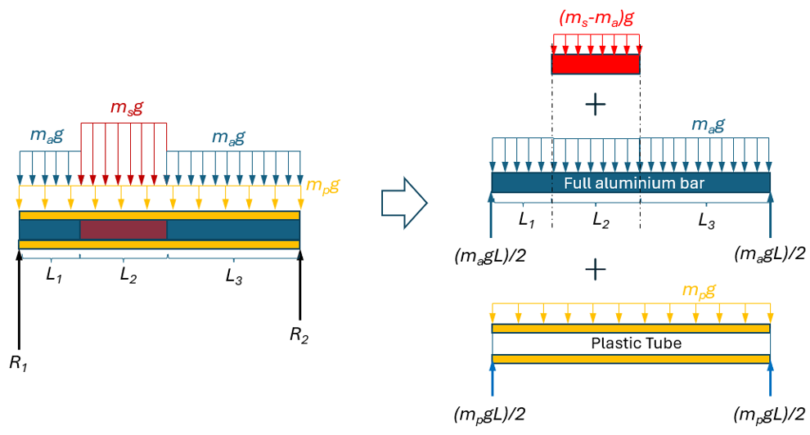
Statics of Mystery Bar…
Changing perspective with Principle of Superposition

Slide 5
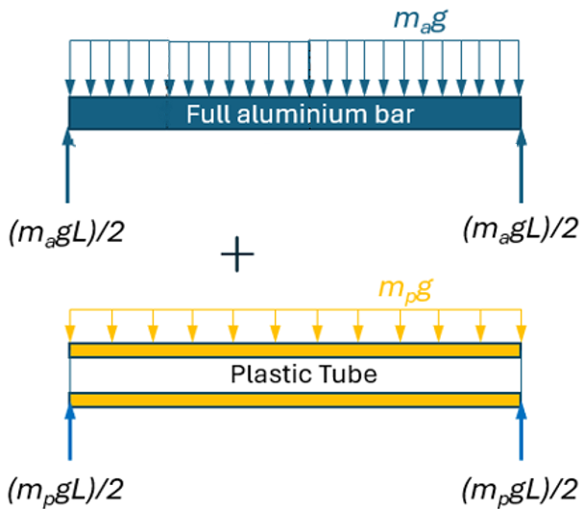
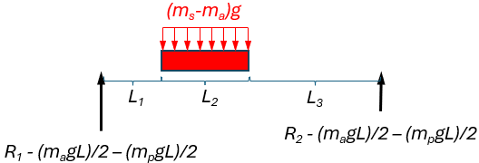
Statics of Mystery Bar…
Apply static analysis to this simplified problem to solve for the lengths of the rods.

Slide 6
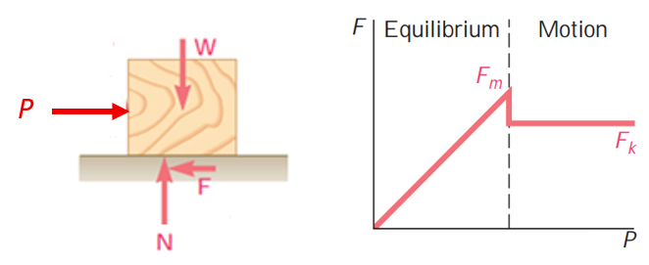
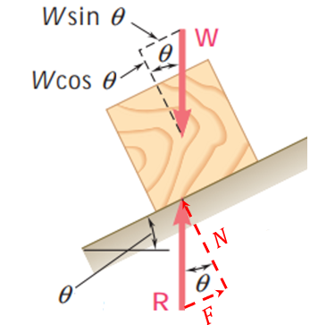

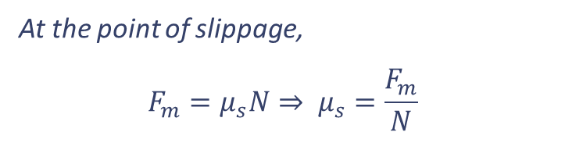

Static Friction
Objective: Using the inclination test to investigate the characteristics of the coefficient of static friction.
At the point of slippage,
$$F_{m}=μ_{s}N⇒ μ_{s}=\frac{F_{m}}{N}$$
$$N=Wcosθ, and F=Wsinθ$$
$$⇒\frac{F}{N}=\frac{Wsinθ}{Wcosθ}=tanθ$$
Again at the point of slippage, $F=F_{m}$ and $θ=Φ$, we have
$$μ_{s}=tanΦ$$

Slide 7
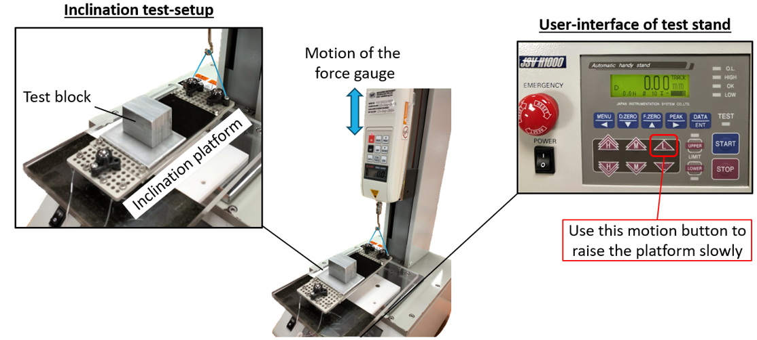
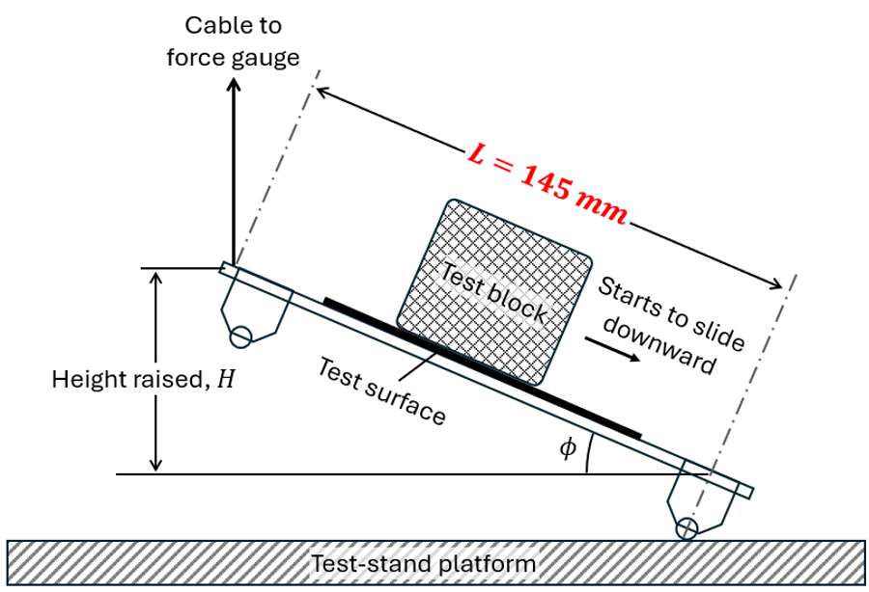
Static Friction…
Established the initial flat position of the platform.
Determine the angles of inclination for different combinations of block and platform surfaces.
Finally, complete the log sheet provided and submit the GROUP report onto the lab folder in CANVAS by the end of the lab session.

